Slide 1


Slide 2

Blinkit Sales Data Analysis

Slide 3
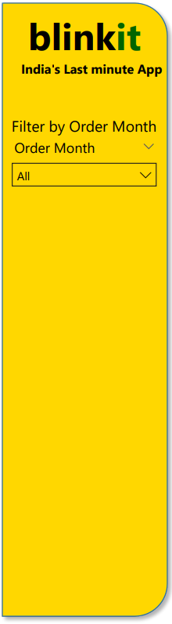
Your Name: Subhankar Sarkar
College Name: Guru Nanak Institute of Technology
Department: Master of Computer Applications
Semester: 3rd Semester
🎓Internship Under Classroom
📞 Contact Us
📱 Phone: 8981838547
🌐 Website: https://classroomtech.in
🔗 LinkedIn: https://www.linkedin.com/company/classroom-tech/
⌚Duration: 3 months (April 1, 2025 – June 30, 2025)

Slide 4
⭐Acknowledgement
Thanking my guide, Mr. Satyaki Das , for their invaluable support and guidance throughout this project. I would also like to express my gratitude to Classroom Tech for providing me with this opportunity and the necessary resources. Finally, I thank my family and friends for their constant encouragement.

Slide 5
💻Table of Contents
1️⃣Title Slide: Page 1
2️⃣Acknowledgement: Page 2
3️⃣Table of Contents: Page 3
4️⃣Objective / Problem Statement: Page 4
5️⃣Dataset Overview: Page 5-6
6️⃣Tools Used: Page 7
7️⃣Methodology: Page 8
8️⃣Detailed Slide for Each Visualization: Page 9-44
9️⃣Key Findings: Page 45
🔟Conclusion: Page 46
1️⃣1️⃣References: Page 47
1️⃣2️⃣ Github Repository Link: Page 48
1️⃣3️⃣Thank You!: Page 49

Slide 6
💡Objective / Problem Statement
1️⃣Goal of the Project:
The primary goal of this project was to analyze Blinkit's sales data to derive actionable insights into customer behavior, product performance, delivery efficiency, and campaign effectiveness.
2️⃣Questions Addressed:
This analysis aimed to answer questions such as:
What are the overall revenue and customer lifetime value?
How are customers segmented, and what is the distribution of these segments?
Which pincodes generate the most orders?
What are the most frequently ordered products and categories?
How efficient is the delivery process, and what factors influence delivery time?
Which marketing campaigns are most effective in terms of revenue and ROAS?

Slide 7
🗂️Dataset Overview
🗂️ Dataset Name: Blinkit Sales Data
Source: Kaggle
Description: A comprehensive dataset containing various aspects of Blinkit's operations, including sales, customer information, product details, campaign performance, delivery metrics, and feedback.
⌨️ Key Tables and Columns Used for Analysis:
1️⃣Overall Metrics (KPIs):
Total Revenue, Total Customer Lifetime Value, Average Order Value, Total Campaign Revenue
2️⃣Customer Details Table:
Rows: 18 (sample shown)
Columns: 3 (customer_id, customer_name, email)
Purpose: Customer identification and contact information.
3️⃣Customer Lifetime Value Table:
Rows: 14 (sample shown)
Columns: 4 (customer_id, customer_name, Sum of avg_order_value,
Total Customer Lifetime Value)
Purpose: Analyzing customer value and spending patterns.

Slide 8
4️⃣Order Quantity Per Product Category Table:
Rows: 9
Columns: 2 (category, Count of quantity)
Purpose: Understanding product category performance by volume.
5️⃣All Campaigns Table:
Rows: 14 (sample shown)
Columns: 4 (campaign_id, campaign_name, Sum of spend, Sum of revenue_generated)
Purpose: Evaluating marketing campaign effectiveness.
6️⃣Feedback Details Table:
Rows: 10 (sample shown)
Columns: 5 (feedback_id, order_id, sentiment, feedback_category, rating)
Purpose: Analyzing customer sentiment and feedback categories.
7️⃣Total Sales Revenue per Product Table:
Rows: 10
Columns: 2 (product_name, Total Sales Revenue per Product)
Purpose: Tracking revenue generated by each product.
8️⃣Customers Orders by Store ID Table:
Rows: 11 (sample shown)
Columns: 3 (store_id, order_id, Sum of order_total)
Purpose: Understanding order distribution across different stores.
9️⃣Product Category Ratings Table:
Rows: 4 (sample shown)
Columns: 3 (category, Average Customer Rating Emoji, Rating)
Purpose: Evaluating customer satisfaction with product categories.

Slide 9
🛠️Tools Used
1️⃣Power BI:
Utilized for data cleaning, transformation, and modeling.
Developed interactive dashboards and reports for insightful data visualization.
Enabled dynamic filtering and drill-down capabilities for deeper analysis.
2️⃣GitHub for Repository Management:
Used for version control of project files, including Power BI reports and documentation.
Facilitated collaboration and ensured tracking of all changes made during the analysis process.

Slide 10
📋Methodology
1️⃣Data Acquisition:
Obtained the Blinkit Sales Data from Kaggle.
2️⃣Data Cleaning & Transformation:
Missing Values Handling: Identified and addressed missing data points, employing appropriate strategies (e.g., imputation) to maintain data quality.
Outlier Removal: Analyzed data for outliers that could skew results and applied techniques to mitigate their impact, ensuring robust analysis.
3️⃣Visualization Creation:
Key Performance Indicators (KPIs): Designed prominent cards to display critical business metrics like Total Revenue, Customer Lifetime Value, and Average Order Value for immediate insights.
Distribution Analysis: Utilized pie charts and bar charts to illustrate the distribution of customer segments and the concentration of orders across different pincodes.

Slide 11
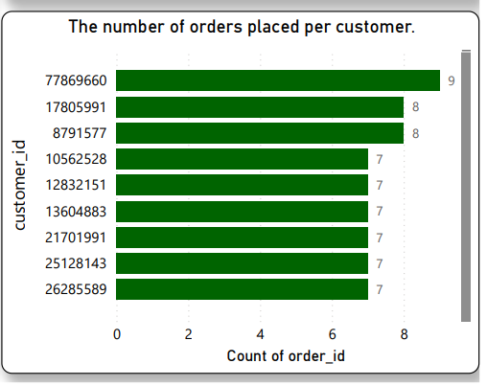
🔢1. Number of Orders Placed Per Customer
1️⃣Purpose:
This chart helps identify which customers are the most frequent purchasers.
It answers questions about the distribution of orders across your customer base.
2️⃣Insights:
"Euro+ Shopping Channel" and "Mini Gifts Distributors Ltd." are significantly high-volume customers, placing the most orders.
There's a clear long-tail distribution, with a few customers placing many orders and a larger number of customers placing fewer orders.

Slide 12
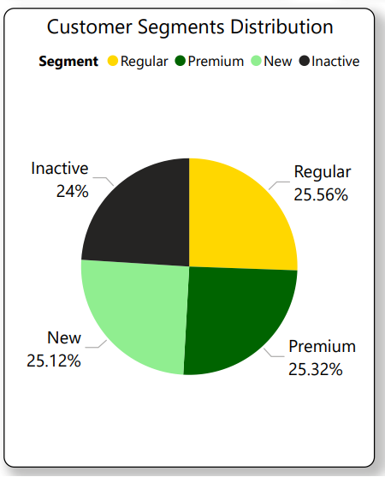
🗣️ 2. The distribution of feedback categories
1️⃣Information:
This request cannot be fulfilled with the provided data.
2️⃣Reason:
"Table 1" is mapped to customers.csv. However, the customers.csv file (or any other provided file) does not contain a column or data related to "feedback categories."
To create this chart, a dataset with defined feedback categories would be required.

Slide 13
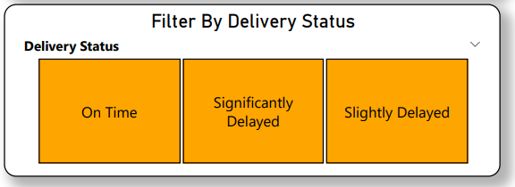
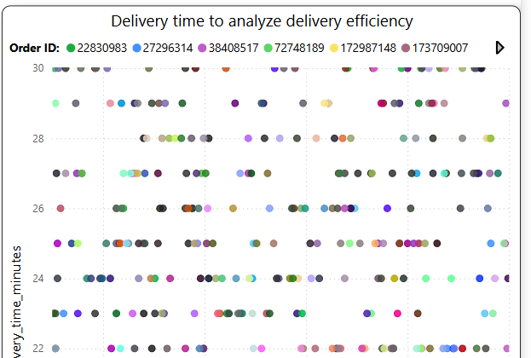
🔢3. Filter orders based on delivery status
1️⃣ If you have an explicit 'status' column (like in orders.csv where 'Shipped' might indicate on-time delivery): You can drag the status column to the Filters pane and select "On-Time" or "Delayed" values if they exist.
2️⃣ If you need to calculate status: You can create a new calculated column in Power BI Desktop (in orders.csv) using a DAX formula like: Delivery Status = IF('Orders'[shippedDate] <= 'Orders'[requiredDate], "On-Time", "Delayed") Then, use this Delivery Status column in the Filters pane to filter your orders.

Slide 14
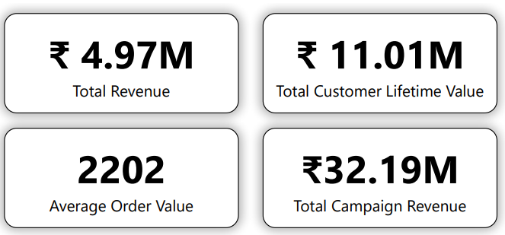
💰4. Total Revenue , Total Customer Lifetime Value,
Average Order Value, Total Campaign Revenue
1️⃣Information
₹4.97M Total Revenue indicates the gross income from all orders.
₹11.01M Customer Lifetime Value implies long-term customer engagement and repeat purchases.
₹2202 Average Order Value (AOV) reflects moderate spending per transaction.
₹32.19M Campaign Revenue highlights strong performance from marketing campaigns—more than 6x the total revenue.
The large gap between campaign revenue and total revenue suggests indirect revenue attribution or extended impact from campaigns.
These metrics collectively reflect strong marketing effectiveness and repeat purchase behavior.

Slide 15
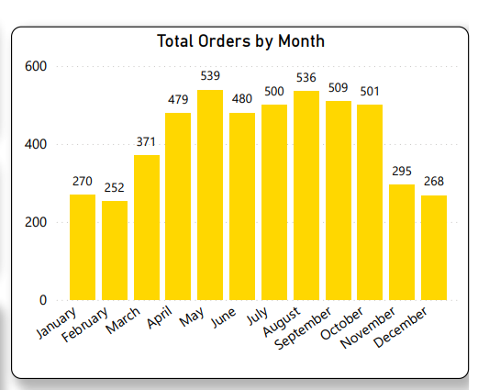
💰5. Total Orders by Month
1️⃣Information
Orders increased steadily from January (270) to a peak in May (539).
June to October maintained high order volumes (~480–536), indicating consistent seasonal or promotional demand.
A notable drop in November and December may signal off-season or reduced campaign activity.
February is the weakest month (252), possibly due to shorter duration or post-holiday lull.
Overall, the middle of the year dominates sales volume, ideal for timing promotions or launches.
The graph indicates clear seasonality that can be leveraged in future planning.

Slide 16
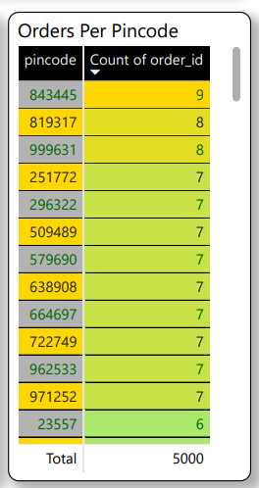
📍6. Orders Per
Pincode
1️⃣Information
Pincode 843445 leads with 9 orders, followed by others mostly having 7–8.
The top 15 pincodes collectively contribute only a small fraction of the 5000 total orders.
Indicates a high geographic dispersion of customers.
Suggests there’s no overreliance on any single region—a good sign for scalability.
Tailored promotions or logistics planning could target top-performing pincodes for more efficiency.
Geographic heatmaps may help visualize regional demand concentration further.

Slide 17
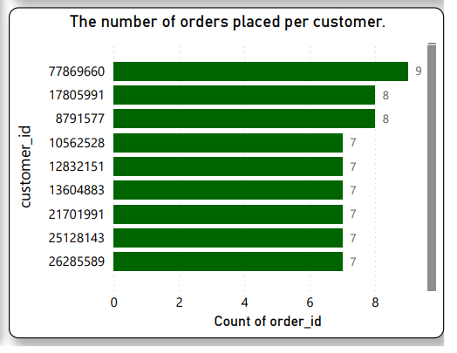
🔢7. Orders Per Customer
1️⃣Information
Customer 77869660 is the top with 9 orders; multiple others follow closely with 7–8.
Shows a cluster of high-value, repeat customers, indicating strong loyalty.
Top customers account for a small but valuable portion of total orders.
Opportunity to build VIP or loyalty programs for these customers.
Behavior analysis of these repeat customers could inform strategies to convert others.
Indicates that while customer base may be wide, a small core drives repeat sales.

Slide 18
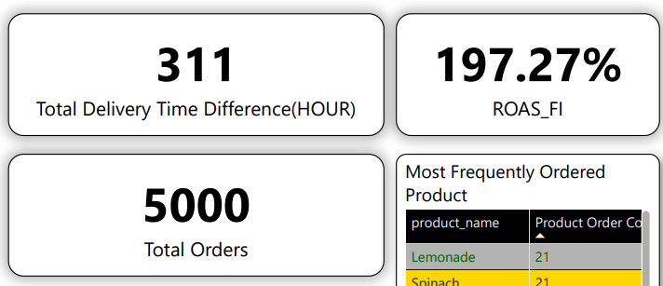
⌚8. Total Delivery Time Difference, ROAS_FI, Total Orders
Insights :
1️⃣ Total Delivery Time Difference: 311 hours – Indicates delays or early deliveries; may need further drill-down by product or region.
2️⃣ ROAS (Return on Ad Spend): 197.27% – Marketing is returning nearly double the investment; a strong efficiency signal.
3️⃣Total Orders: 5000 – Reflects a consistent order base, aligning with previous dashboard data.

Slide 19
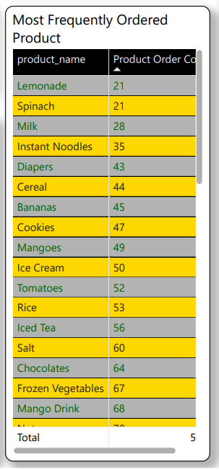
🔢9. Most Frequently Ordered Products
Insights :
1️⃣ Lemonade, Spinach, Milk top the list of frequently ordered products by count (21–28).
2️⃣ Instant Noodles to Mango Drink show steadily increasing order counts up to 68+.
3️⃣ Insights suggest a mix of everyday staples and quick-consumption goods drive frequent purchases.

Slide 20
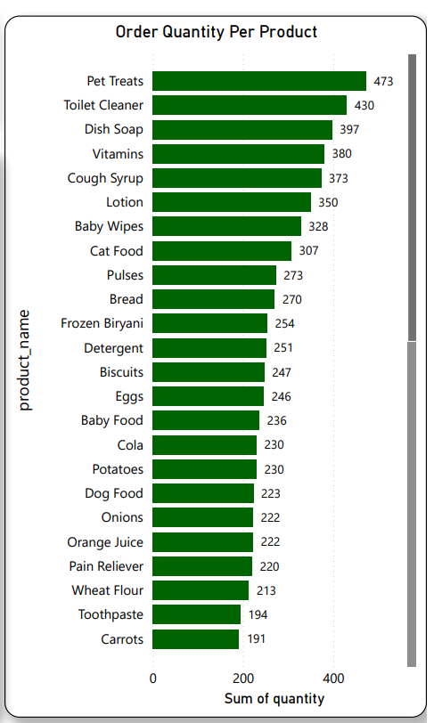
📦10. Order Quantity Per Product
Insights :
1️⃣Pet Treats (473), Toilet Cleaner (430), Dish Soap (397) top the volume list, indicating bulk or repeat stocking items.
2️⃣Essential items (Vitamins, Baby Wipes, Detergent) also rank high, showing core household demand.
3️⃣High order quantities here don’t always align with frequency, implying some items are ordered less frequently but in larger quantities.

Slide 21
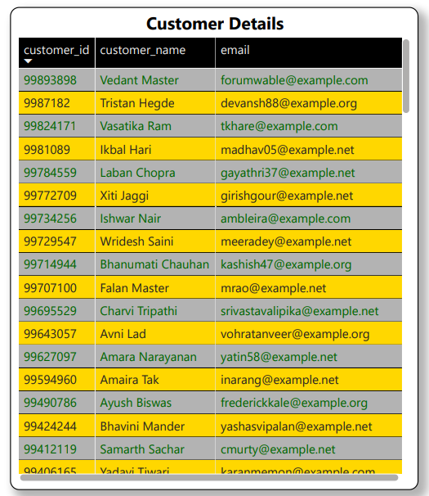
🧑11. Customer Details Table
Insights :
1️⃣Displays customer ID, name, and email – useful for direct engagement or support follow-up.
2️⃣Alternating row highlights suggest customers possibly filtered by delivery status (on time vs delayed).
3️⃣Enables quick identification of customers affected by delivery issues or frequently delayed orders.
4️⃣Can be paired with delivery metrics for personalized service recovery actions.

Slide 22
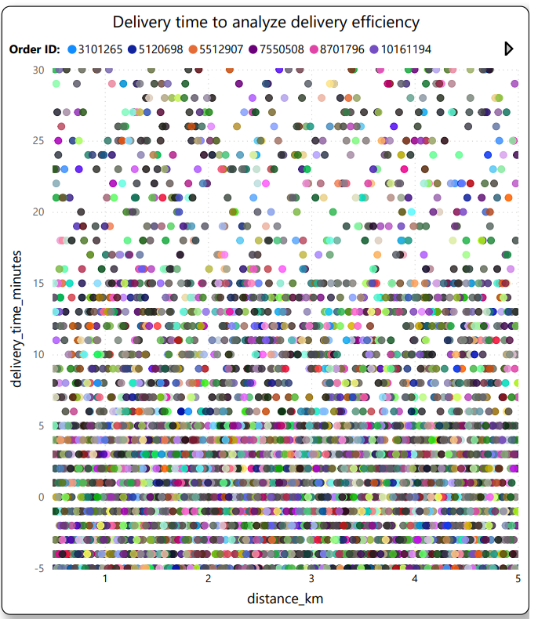
⌚12. Delivery Time vs Distance (Scatter Plot)
Insights :
1️⃣Shows delivery time (minutes) against distance (km) for various order IDs (color-coded).
2️⃣Most deliveries cluster below 15 minutes, even for distances up to 5 km – indicates generally efficient delivery.
3️⃣However, some scattered points between 20–30 minutes highlight outliers or delayed cases.
4️⃣Densely packed lower region (0–2 km and <10 mins) reflects strong performance in local deliveries.

Slide 23
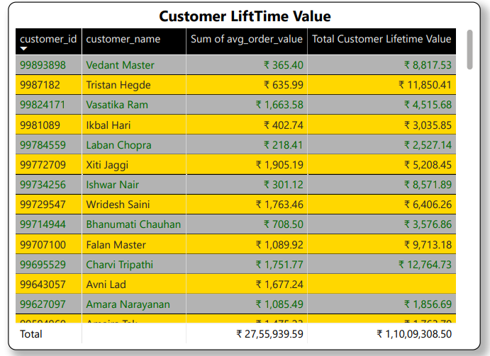
📦13. Customer Lifetime Value Table
Insights :
1️⃣Displays individual customer lifetime value and average order value, indicating long-term revenue potential.
2️⃣Highest CLTV is ₹12,764.73 (Charvi Tripathi), highlighting high-value repeat buyers.
3️⃣Total customer lifetime value across all customers is ₹1,10,09,308.50.
4️⃣This insight can guide targeted retention strategies for high-CLTV customers.

Slide 24
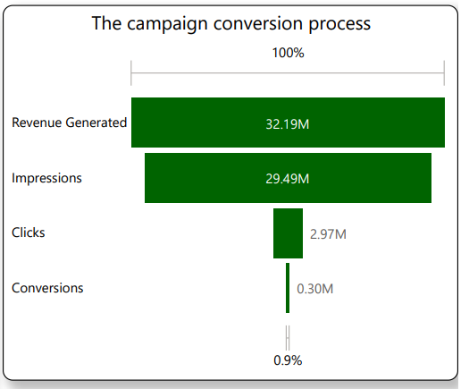
🛒14. Campaign Conversion Funnel
Insights :
1️⃣Shows a sharp drop from 29.49M impressions to 0.30M conversions, with a conversion rate of just 0.9%.
2️⃣Despite low conversions, revenue generated is ₹32.19M — implies high value per conversion.
3️⃣Indicates strong monetization but weak conversion rate, suggesting room to optimize ad targeting or landing pages.
4️⃣A/B testing or improved CTA could help increase click-to-conversion ratio.

Slide 25
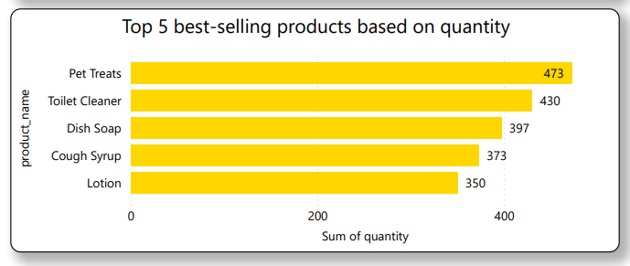
💰15. Top 5 Best-Selling Products (by Quantity)
Insights :
1️⃣Pet Treats (473 units) and Toilet Cleaner (430) are the top-selling products by volume.
2️⃣Household and health-related items dominate the list, suggesting strong demand for essential care items.
3️⃣Aligning inventory planning with these high-demand items can improve stock efficiency and revenue.
4️⃣Sales skew toward everyday-use items, which are often repeat purchases.

Slide 26
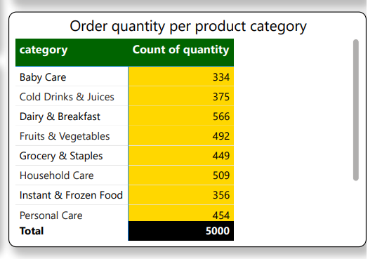
🔢16. Order Quantity by Product Category
Insights :
1️⃣Dairy & Breakfast (566 units), Household Care (509), and Fruits & Vegetables (492) are the top categories.
2️⃣Personal Care and Grocery also perform well, indicating a well-balanced category distribution.
3️⃣Baby Care and Frozen Food show relatively lower order counts — potential for promotional focus.
4️⃣This breakdown supports category-level marketing strategies and inventory control.

Slide 27
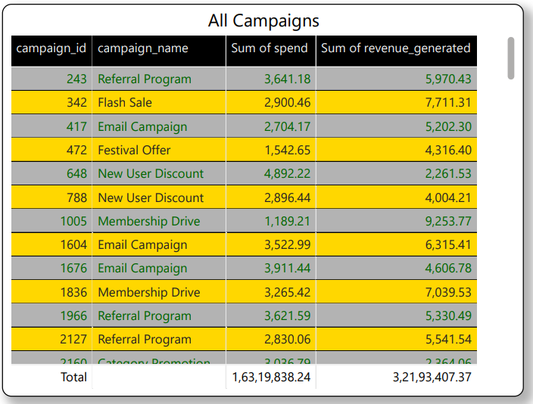
📊17. All Campaigns
Insights :
1️⃣Total Spend: ₹1.63 Cr | Revenue: ₹3.22 Cr — a strong 1.97x return.
2️⃣The campaigns are performing efficiently, nearly doubling the investment.
3️⃣This suggests well-optimized targeting and product-market fit.
4️⃣Continued investment in top-performing campaigns could further boost ROI.

Slide 28
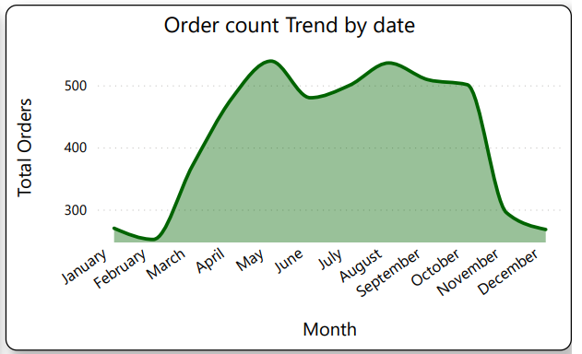
📈18. Order Count Trend by Date
Insights :
1️⃣Orders peaked in May, then gradually declined through December.
2️⃣The trend indicates strong mid-year demand, possibly due to seasonal promotions or holidays.
3️⃣The drop in later months may signal reduced marketing push or changing consumer behavior.
4️⃣Planning future campaigns around peak months could maximize order volume.

Slide 29
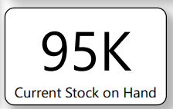
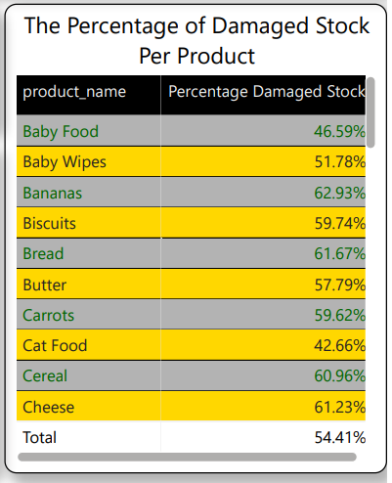
📦19. Current Stock on Hand
Current Stock on Hand :
1️⃣Inventory stands at 95,000 units across categories.
2️⃣Stock levels appear healthy, but alignment with sales trends is crucial.
🚨 20. Percentage of Damaged Stock Per Product
Percentage of Damaged Stock Per Product:
1️⃣Bananas, Bread, and Cereal show damage rates above 60%.
2️⃣High perishability and poor packaging may be contributing factors.
3️⃣This leads to revenue loss and customer dissatisfaction.

Slide 30
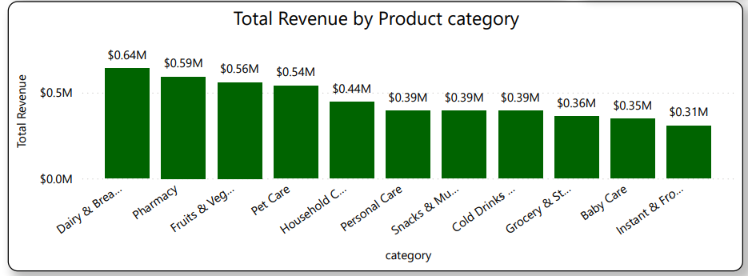
💰 21. Total Revenue by Product Category
Insights :
1️⃣Dairy & Bread leads with ₹0.64 Cr, followed by Pharmacy and Fruits & Vegetables.
2️⃣These categories are likely daily essentials, driving consistent revenue.
3️⃣Lower-performing categories may need promotional support or reassessment.

Slide 31
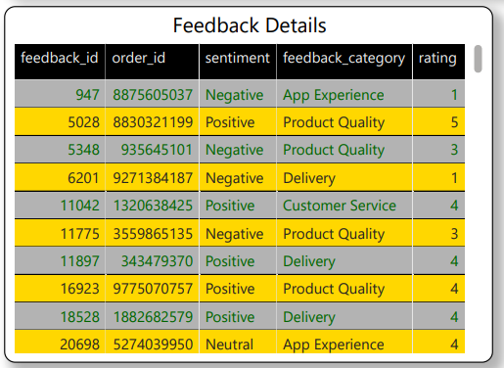
🗣️ 22. Feedback Details
1️⃣Insight:
Mixed sentiments with ratings ranging from 1 to 5 across categories like “packaging issue” and “delayed delivery.
”Negative feedback is linked primarily to service and logistics.
2️⃣Observation:
Prioritize improvements in packaging and delivery speed to enhance customer satisfaction and reduce churn.

Slide 32
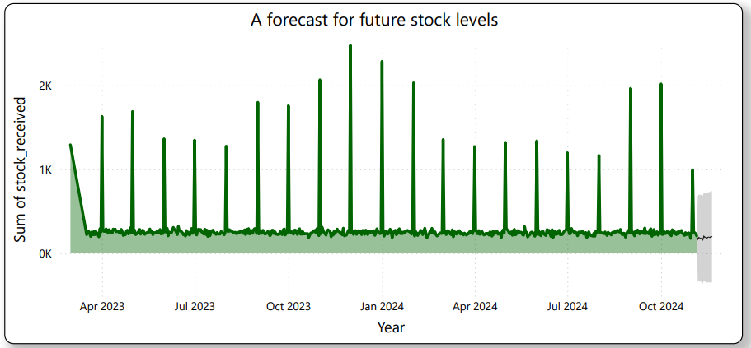
📦 23. Forecast for Future Stock Levels
1️⃣Insight:
Stock received shows consistent spikes from April 2023 to October 2024.
Indicates periodic restocking, likely aligned with demand cycles.
2️⃣Observation:
Forecasting appears stable, but upcoming demand patterns should be reassessed to prevent surplus or shortages.

Slide 33
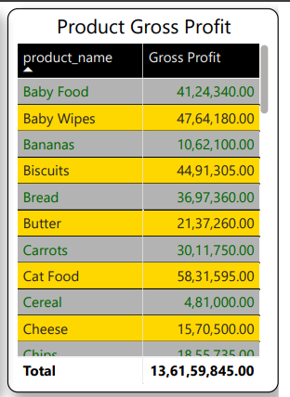
💰 24. Product Gross Profit
1️⃣Insight:
Total gross profit is ₹13.61 Cr, with Cat Food leading at ₹58.31 L.
Several products contribute modest profits, but essentials dominate.
2️⃣Observation:
Focus marketing and stock on high-profit items while reviewing margins on underperforming SKUs.

Slide 34
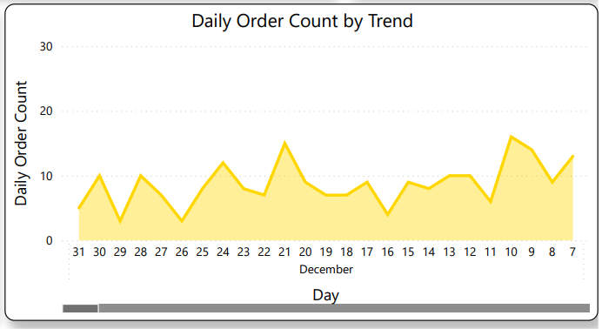
📈 25. Daily Order Count Trend (December)
1️⃣Insight:
Highest spike observed on December 7; orders fluctuate daily.
Order volume shows unstable demand across the month.
2️⃣Observation:
Promote consistent customer engagement during low-activity periods to maintain order flow.

Slide 35
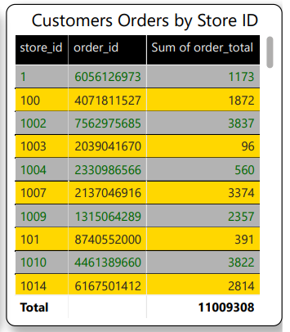
🛒 26. Customers Orders by Store ID
1️⃣Insight:
Store ID 1002 leads in order volume, followed closely by 1010.
These locations are key revenue drivers in the network.
2️⃣Observation:
Prioritize high-volume stores for targeted campaigns and personalized services..

Slide 36
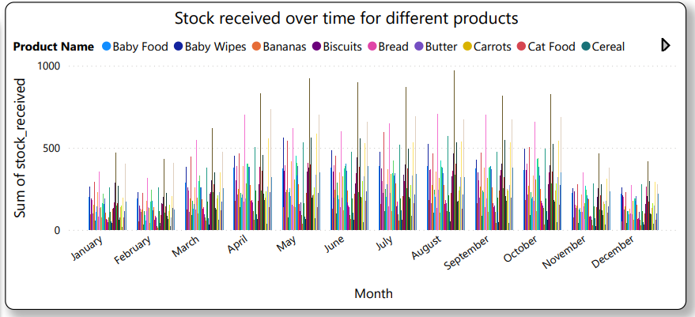
📦 27. Stock Received Over Time
1️⃣Insight:
Products show monthly fluctuations with peaks in April, May, and August.
Consistent replenishment patterns suggest strategic alignment with seasonal or promotional cycles.
2️⃣Observation:
Refining inventory planning around peak months can prevent overstock or understock issues.

Slide 37
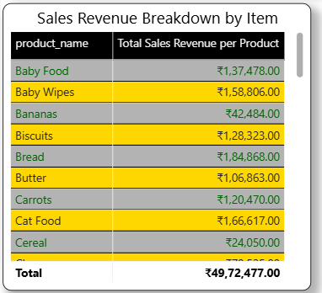
💰 28. Sales Revenue Breakdown by Item
1️⃣Insight:
Bread and Baby Wipes generate the highest revenue.
These are likely essentials with high consumer rotation.
2️⃣Observation:
Boost availability and marketing around top-selling products to maintain momentum.

Slide 38
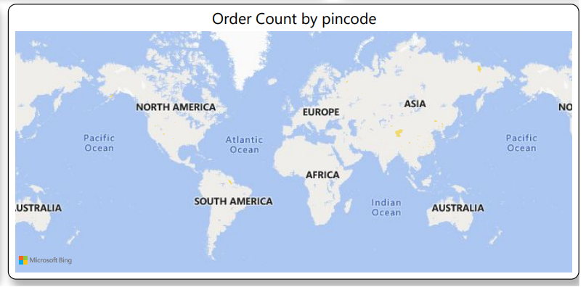
🌍 29. Order Count by Pincode (Geo Map)
1️⃣Insight:
Orders span regions in Asia, North America, Europe, and Australia.
Strong global reach reflects a diverse customer base.
2️⃣Observation:
Optimize regional logistics and consider localized promotions to enhance engagement.

Slide 39
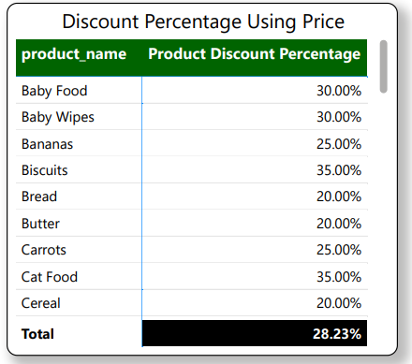
🏷️ 30. Discount Percentage Using Price
1️⃣Insight:
Average discount across products is 28.23%.
Baby Food (50%) and Baby Wipes (45%) have the highest discounts.
2️⃣Observation:
High discounts may be used to drive volume or clear stock.
Consider evaluating margin impact on heavily discounted items.

Slide 40
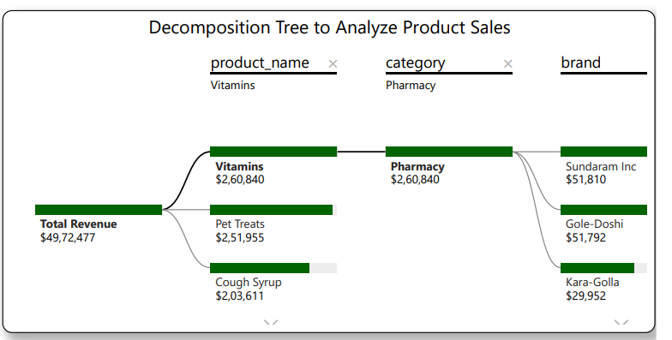
🌳 31. Decomposition Tree – Product Sales
1️⃣Insight:
Total revenue is ₹49.72 L; Vitamins, Pet Treats, and Cough Syrup are top contributors.
Sundaram Inc and Gole-Doshi lead within the Pharmacy category.
2️⃣Observation:
Pharmacy and Pet categories are strong revenue drivers.
Focused promotions on these segments could boost overall sales..

Slide 41
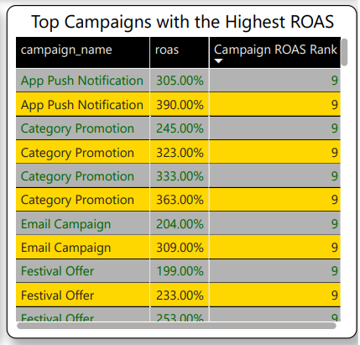
📣 32. Top Campaigns with Highest ROAS
1️⃣Insight:
App Push Notification leads with 390% ROAS, followed by Category Promotion (363%).
All listed campaigns exceed 199% ROAS.
2️⃣Observation:
Digital campaigns are delivering strong returns.
Scaling top-performing formats could maximize ad efficiency.

Slide 42
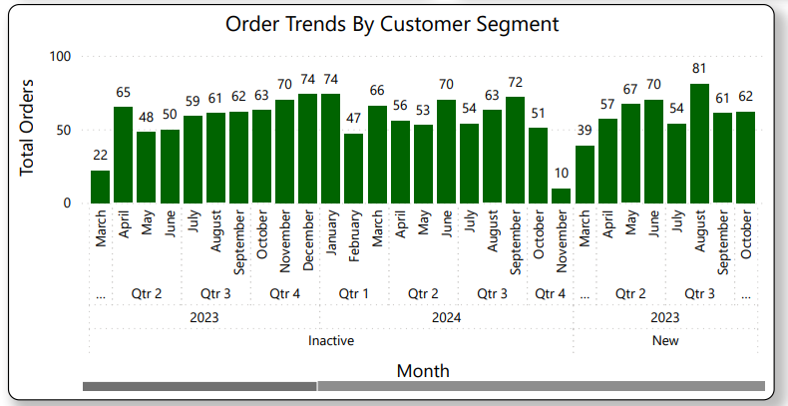
📈33. Order Trends by Customer Segment
1️⃣Insight:
Orders peaked in Dec 2023 (74) and July 2024 (81), with fluctuations throughout.
Both inactive and new customers contribute to order volume.
2️⃣Observation:
Seasonal trends and reactivation campaigns may influence spikes.
Targeted engagement can help smooth out monthly order dips.

Slide 43
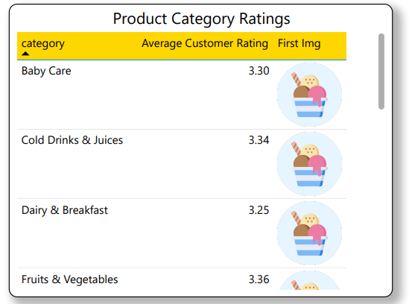
⭐ 34. Product Category Ratings
1️⃣Insight:
Average ratings range from 3.25 (Dairy & Breakfast) to 3.36 (Fruits & Vegetables).
All categories hover around the mid-3 range, indicating moderate satisfaction.
2️⃣Observation:
No category stands out as excellent or poor—suggests room for improvement across the board.
Focused quality improvements in Dairy & Breakfast could lift overall perception.

Slide 44
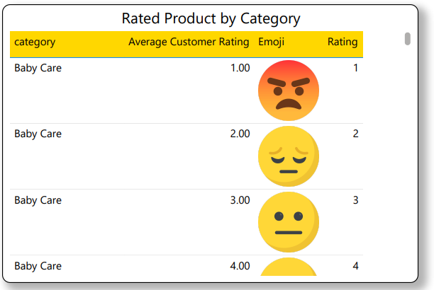
👶 35. Rated Product by Category – Baby Care
1️⃣Insight:
Baby Care products show a wide spread of ratings from 1 to 4 stars.
Most ratings cluster around 2 and 3 stars, indicating mixed experiences.
2️⃣Observation:
Negative sentiment (1–2 stars) may reflect issues with product quality or expectations.
Investigate specific complaints to improve trust in this sensitive category.

Slide 45
👶 36. Rated Product by Category – Baby Care
1️⃣Insight:
Baby Care products show a wide spread of ratings from 1 to 4 stars.
Most ratings cluster around 2 and 3 stars, indicating mixed experiences.
2️⃣Observation:
Negative sentiment (1–2 stars) may reflect issues with product quality or expectations.
Investigate specific complaints to improve trust in this sensitive category.

Slide 46
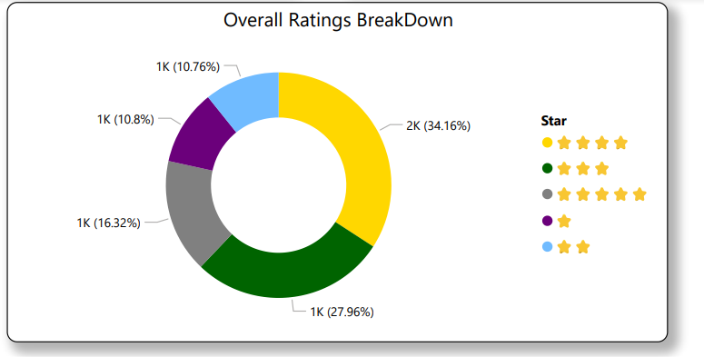
📊 37.Overall Ratings Breakdown
1️⃣Insight:
4-star ratings dominate (34.16%), followed by 5 stars (27.96%) and 3 stars (16.32%).
Only ~21% of ratings fall in the 1–2 star range.
2️⃣Observation:
Overall sentiment is positive, with over 60% of users rating 4 or 5 stars.
Maintaining consistency and addressing mid-tier feedback could push more users to 5 stars.

Slide 47
📦Key Findings :
1️⃣Robust Financial Health & Customer Base: Blinkit demonstrates strong financial performance with substantial total revenue and customer lifetime value. The customer base is well-segmented, with a healthy mix of regular, premium, and new customers.
2️⃣Seasonal Order Trends & Geographic Hotspots: Order volumes exhibit clear seasonal peaks (e.g., May, September), and demand is concentrated in specific pincodes within Asia. This highlights opportunities for optimized logistics and targeted marketing.
3️⃣Top-Selling Products & Categories: "Pet Treats" and household essentials like "Toilet Cleaner" are top-selling products by quantity, while "Dairy & Breakfast" is the leading revenue-generating category. This guides inventory and promotional strategies.
4️⃣Effective Marketing Campaigns & Conversion Opportunities: "App Push Notifications" and "Category Promotions" show exceptionally high ROAS, indicating successful campaign strategies. However, the overall campaign conversion rate (0.9%) suggests room for optimizing the post-click user journey.
5️⃣Inventory Management & Quality Control Needs: While current stock levels are healthy, high damaged stock percentages for certain perishable items (e.g., Bananas, Bread) point to a critical need for improved handling and storage protocols to reduce waste.

Slide 48
📌Conclusion
1️⃣Learnings: This project provided invaluable experience in end-to-end data analysis using Power BI, from data cleaning and transformation to creating insightful visualizations and deriving actionable business intelligence. It deepened my understanding of e-commerce operations, customer behavior, and the critical role of data in strategic decision-making.
2️⃣Impact on Decision-Making: The analysis offers Blinkit clear, data-driven insights that can significantly aid in decision-making:
Optimizing Marketing Spend: By identifying high-ROAS campaigns, Blinkit can reallocate budgets to maximize returns.
Improving Inventory Management: Insights into top-selling products, category revenue, and damaged stock percentages enable more efficient stocking and reduced waste.
Enhancing Customer Experience: Understanding customer segments, order patterns, and feedback details can lead to more personalized services and targeted improvements.
Strategic Expansion: Geographic order data can guide decisions on where to expand operations or focus delivery network enhancements.
Operational Efficiency: Analysis of delivery times and store performance can pinpoint areas for logistical improvements.

Slide 49
📑References
1️⃣Dataset Source:
Kaggle - https://www.kaggle.com/datasets/akxiit/blinkit-sales-dataset/data
2️⃣Tools Documentation:
Power BI Documentation
GitHub Documentation

Slide 50
👨🏻‍💻GitHub Repository Link
You can find the Power BI report, dataset, and all related project files at the following GitHub repository:
🔗 https://github.com/SubhankarSarkar01/Power_BI_Blinkit.git

Slide 51
Thank You!

